Slide 1

Advancements in Multinational License Plate Recognition: Harnessing Generalized Character Sequence Detection

Slide 2
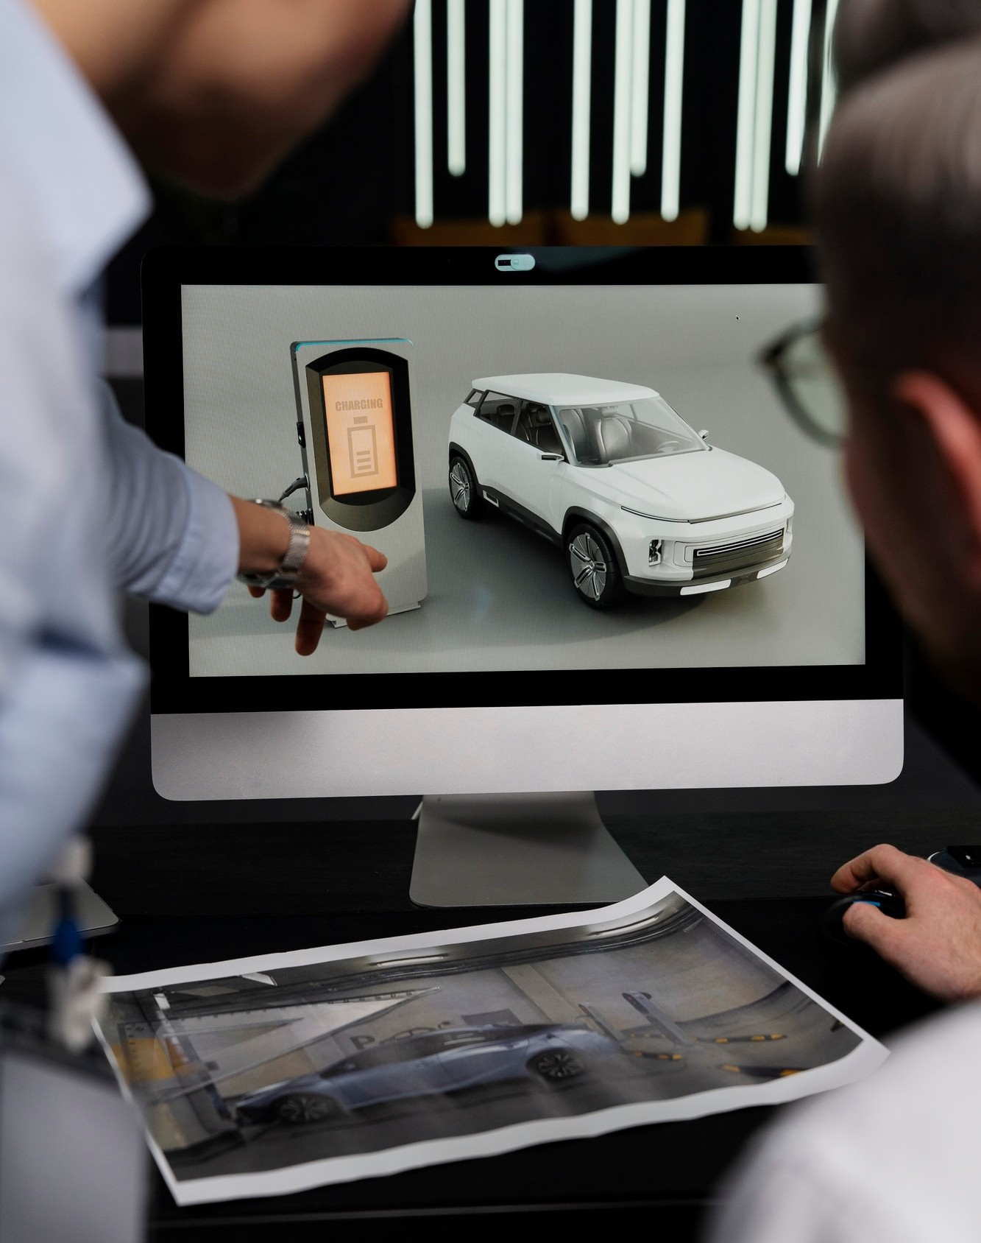
Introduction
The advancements in Multinational License Plate Recognition have revolutionized vehicle tracking and law enforcement. This presentation explores the potential of Generalized Character Sequence Detection in enhancing this technology.

Slide 3
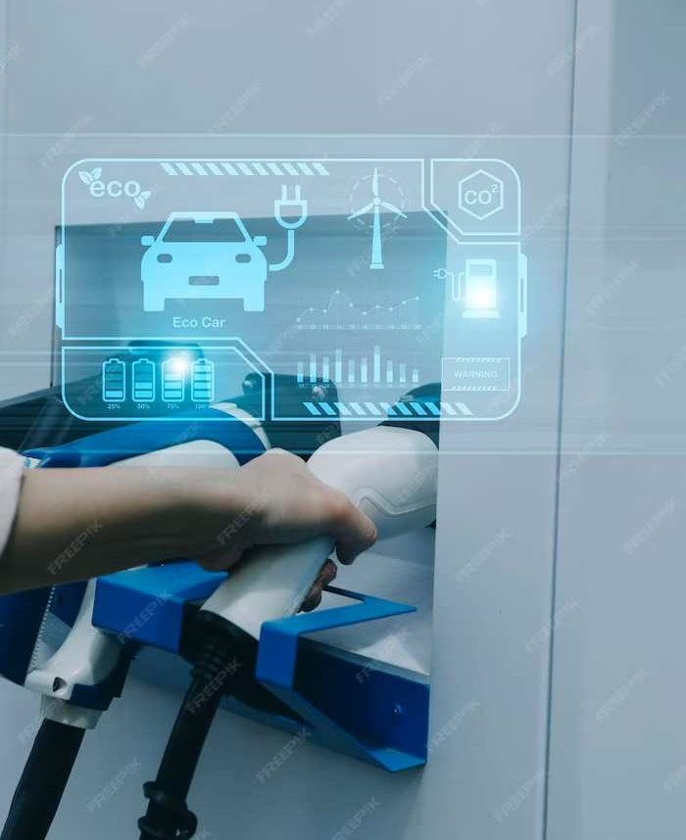
Contributions
Development of a multinational LPR systemExploration and adaptation of existing LPR techniquesEvaluation on datasets with license plates from multiple countries

Slide 4

Character sequence detection algorithmAdaptation of LPR techniques for diverse character setsTraining and testing on a dataset with global license plates

Slide 5

Methodology(cont.)
Illustration: Algorithm implementation diagram:
Adaptation process for diverse character setsImage:
Training and testing process on global
dataset

Slide 6
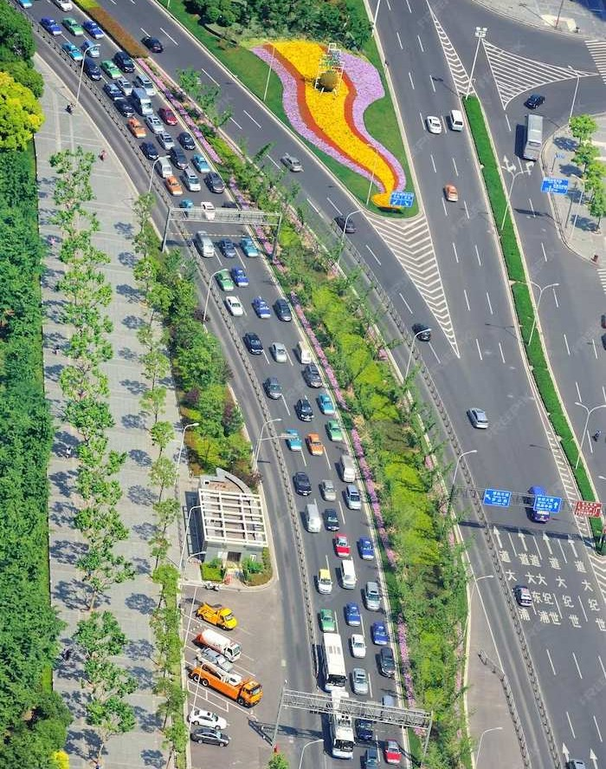
Conclusion
Key FindingsEffectiveness of the proposed
multinational LPR systemPotential Applications in real-world scenariosSigniﬁcance of a versatile LPR system for global use

Slide 7

Limitation 1
First Limitation: Lack of detailed analysis on speciﬁc subsets Challenges: Unique character variations, fonts, and plate designs Suggestion: More granular examination on a per- country/region basis

Slide 8

Limitation 2
Second Limitation: Absence of comparative analysis.
Issue: No comparison with existing
state-of-the-art LPR systems Recommendation: Thorough comparison with other multinational LPR approaches

Slide 9
Conclusion
Overall Contribution: Signiﬁcant advancement in multinational LPR
Strengths: Generalized approach, promising methodology Weaknesses: Lack of detailed subset analysis, comparative analysis
Future Research: Address identiﬁed limitations for a more
comprehensive solution

Slide 10



Thanks!
Do you have any questions? youremail@email.com
+91 620 421 838
www.yourwebsite.com @yourusername

